Slide 1

Making private antitrust damages actions more effective in Europe
Andrea Renda
Senior Research Fellow, Centre for European Policy Studies
LEAR Conference, Rome 26 June 2009

Slide 2
Introduction
2
Private antitrust litigation already exists in most of the EU27. But damages actions are very uncommon
Private enforcement is already possible since the Rome Treaty, as Articles 81 and 82 of the Treaty are directly applicable in member states
Since 1973, the Commission has repeatedly expressed the view that private actions can provide a useful complement to its role as public enforcer
Modernization strenghtened this view, by decentralising the application of antitrust law
The ECJ decisions in Courage v. Crehan and Manfredi highlighted the possibility for victims to claim damages before national courts
Notes:
Here I just have to explain where we are:
Possible since 1957
Modernization increase the decentralized application of EC Competition law
Ashurst study found “total underdevelopment” in 2004
Things have only marginally changed since then
In the US, 90:1 or 95:1, in Europe it’s the reverse
A Green Paper was issued in 2005 w/36 options
A White Paper will be published in late March 2008

Slide 3
Existing obstacles in the EU
3
As reported by the Ashurst Study in 2004, the major obstacles are access to evidence rules and legal uncertainty
EU antitrust was born as public enforcement
Victims often have limited knowledge of harm
Some violations are difficult to detect
Some conducts create scattered damages
Burden of proof (threshold), access to evidence
Absence of conditional/contingency fees
Quasi-absence of group litigation
“English rule”
Legal uncertainty
Lack of skills in courts

Slide 4
Persisting underdevelopment
4
A slight development of damages actions was observed in 2004-2007. But it is mostly confined to isolated streams of cases, and seldom successful
Ashurst study found “total underdevelopment”
  60 actions and 23 damage awards in over 50 years (plus settlements and arbitral awards)
From underdevelopment to fragmentation?
  Between 1st of May 2004 - 3Q2007, 96 antitrust damages actions for the EU27
  Private antitrust damages actions were observed only in 10 of the EU27
  Vertical restraints cases are the most common (61), but damages have never been awarded
  Limited number of “clusters” of claims

Slide 5
2004-2007 developments
5

Slide 6
2004-2007 developments
6

Slide 7
2004-2007 developments
7

Slide 8
Awards by type of claim, 2004-07
Year | Vertical (damages awarded) | Abuse (damages awarded) | Cartel (damages awarded) | Total (damages awarded)
2004 | 22 (1) | 11 (2) | 3 (1) | 36 (4)
2005 | 30 (0) | 12 (6) | 6 (5) | 48 (11)
2006 | 13 (0) | 5 (2) | - | 18 (2)
2007 (I sem.) | 3 (0) | 1 (0) | 2 (1) | 6 (1)
Total | 68 (1)* | 29 (10)** | 11 (7) | 108 (18)
*The damage award in 2004 in the Crehan judgment was overturned by the House of Lords in 2006.
**The damages awarded in Attheraces Limited and another / British Horseracing Board have been repealed by the High Court, even if the parties had already settled the case for £1 million.

Slide 9
Why private damages actions?
9
Private antitrust damages actions can realise the “invisible hand”: the self-interest of victims can favour the public interest
Corrective justice
  Right to damages is rooted in Community law
  ECJ in Courage (2001) and Manfredi (2006)
Additional deterrence
  Public enforcers have limited resources
  Damage awards add to public fines
  “Private Attorneys Generals” can be more informed
Internal market effects
  Exercise of the right to damage in the EU27
  Level-playing field for firm engaging in cross-border trade
Macroeconomic effects
Notes:
There are many reasons, the most important are:
Deterrence: (i) current public enforcement has limited resources, and especially in the case of cartels, it will never capture all infringements; (ii) private attorney generals often have more information, especially for certain types of infringements; (iii) private sanctions add to public fines; (iv) fear of reputational effects and stock exchange breakdowns; (vi) internalisation of externalities
Corrective justice: (i) torts go unpunished; (ii) need for redress
Macroeconomic effects?

Slide 10
The “second pillar”
10
Nature
Private antitrust enforcement can effectively create a second pillar, but also more opportunities for strategic lawsuits and court error
Legal
Illegal
Firm 1
Firm 1
Action
No action
No action
Action
Signal
Signal
Legal
Illegal
Illegal
Legal
NCA (public enforcement)
Nature
Nature
Not guilty
(correct)
Guilty
(Type I)
Guilty
(correct)
Not guilty
(Type II)
Player 2
Player 2
No action
Action
Follow-on suits
Action
No action
Not guilty
(correct)
Guilty
(Type I)
Guilty
(correct)
Not guilty
(Type II)

Slide 11
Deterrence: “Magic formula”
11
When will a firm infringe?
Public enforcement
Private damages actions
Probability of detection
Probability of detection
Expected liability
Expected fine
Expected award or settlement
Reputational effects
E(C) = p_{g}c_{g}E(F) + p_{p}c_{p}E(S) + E(R)
Probability of conviction
Probability of conviction

Slide 12
Deterrence: cartels (I)
12
Source | Probability
Landes (1983) | 0.33
USSD (1986:15) | 0.10
Cohen and Scheffman (1989) | 0.33
Beckstein and Gabel (1982) | Less than 0.50
Feinberg (1985:379) | Less than 0.50
Werden-Simon (1987) | Less than 0.10
Bryant-Eckard (1991) | 0.13-0.17
OECD (2002: 19) | 0.13-0.17
Golub et al. (2005) | 0.13-0.17
Wils (2005:30) | Less than 0.33
Wils (2006: 24) | 0.16
Schinkel (2006:25) | 0.15
Bush et al. (2004) | 0.10-0.33
Stucke (2006:47) | unknown
Combe-Monnier (2007) | 0.129-0.132
According to some authors, the “optimal fine” would reach several times the overcharge, or even more..
.. But there is a limit (the firm’s ability to pay)

Slide 13
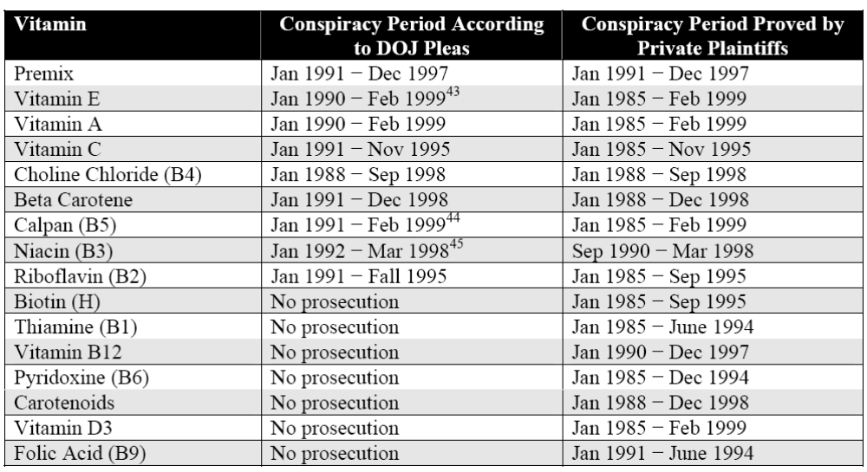
Deterrence: cartels (II)
13
Source: Lande and Davis (2006)

Slide 14
Impact on the detection rate
Lande and Davis (2008) analyse forty of the largest recent antitrust cases or group of cases in the US, and find a significant number of privately initiated cases
“…we were somewhat surprised at the high representation of private actions that were filed in the absence of government cases or that significantly expanded the relief obtained through government enforcement alone…
…of the total amount recovered almost half—at least forty-three to forty-seven percent; $7.631 to $8.981 billion—came from the fifteen cases that did not follow federal, State, or EU government enforcement . For each of the cases … the private plaintiffs completely uncovered the violations, and initiated and pursued the litigation, with the government following the private plaintiffs’ lead or playing no role at all.
Another $4.212 billion came from cases with a mixed private/public origin".
Lande and Davis (2008)

Slide 15
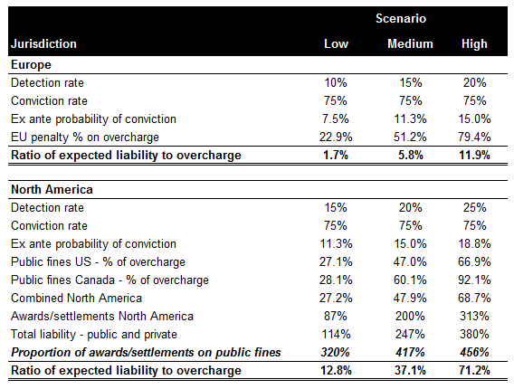
Deterrence: cartels (III)
15
Notes:
Maybe my tables on deterrence rate?

Slide 16
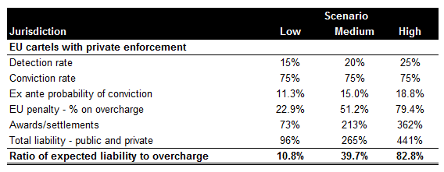
Deterrence: cartels (IV)
16
Notes:
Maybe my tables on deterrence rate?

Slide 17
Standing to sue
17
Anticompetitive conduct may damage different categories of players
The infringer should internalise all negative externalities it imposes
Several categories of cartel victims:
  direct purchasers, downstream firms or final customers
  indirect purchasers (if the overcharge was passed-on)
  customers who purchased from fringe firms outside the cartel that charged a higher price as a non-cooperative response to the cartel price
  those who would have purchased the cartel product, but who either did not purchase at all, or purchased a less-preferred alternative outside the cartel
  suppliers to the cartel or to other firms who sell products that contain the cartelised input, who both sell less because of the output restriction at the cartel price. This is the so-called “umbrella effect” of a cartel.
All of them have standing in the EU (but need to prove causation) – See ECJ in Manfredi (2006)

Slide 18
Another “Magic formula”
18
When will a victim sue?
Litigation part
Settlement part
Expected damage award
Expected settlement
Litigation costs
Settlement costs
p[wD – (OC_{t} + LC_{t} + AC)] + (1 – p)[S – (OC_{s} + LC_{s})] > 0
Probability of winning at trial

Slide 19
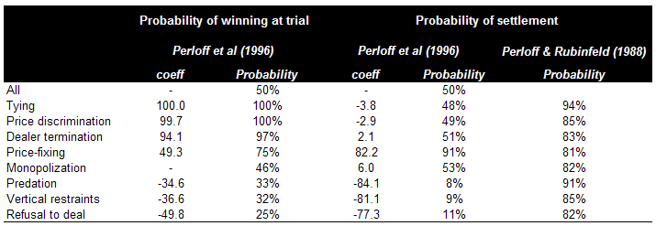
Winning and settling
19
Georgetown study data (1973-1983)
Notes:
Maybe my tables on deterrence rate?

Slide 20
The costs of private enforcement
20
Costs associated with enhanced private enforcement never outweigh the potential benefits, but can be significant
Litigation costs
  Average lawyers’ fees reach 10%-20% of final awards in the US
  Court fees average 2%-6% of final award in the EU
  Opportunity cost of litigation: 53%-79% of attorneys’ fees (Lande, 1993)
  In Europe, would not be necessarily lower than in the US, despite the absence of contingency fees
Cost of the judicial system
  Up to 16.5% of the nominal income transfer (untrebled damage award)
Notes:
Data from Georgetown

Slide 21
Frivolous suits?
21
Many authors have reported cases of nuisance suits in the US; lately, the Supreme Court strengthened pleading requirements in Twombly
Private parties may have an incentive to strategically use the legal system to:
  Impose costs on rivals
  Sue and settle
  Gain access to confidential information
Incentives increase with:
  Damage multiples
  Low pleading thresholds
  Asymmetric fee-shifting rules
Notes:
Data from Georgetown

Slide 22
Overshooting?
22
Measures that encourage too much litigation may even result in “equilibrating tendencies”, such as in the US
(Calkins, 1986 Kovacic, 2007)
Over-deterrence
  Firms may refrain from adopting efficient behaviour because expected liability is too high
  This is especially likely in vertical restraints and abuses (more generally, in rule of reason cases)
Over-compensation
  Whenever a claimant is awarded more than the loss sustained
  May occur in case of duplicative liability (e.g. when passing-on defence is not allowed)
  Necessary for access to justice?
  Necessary for sufficient deterrence?

Slide 23
Harmonisation costs
23
Private antitrust enforcement can represent a new paradigm for Europe and access to justice.
But the way forward is still uncertain
Whatever measure is adopted to encourage private antitrust damages actions, harmonisation costs will be high
  Damage multiples against ordre public in many countries
    Also in the UK (See Devenish, 2007)
  Limitation periods vary widely
  Opt-out group litigation against constitutional principles in many Member States
  Very difficult to change access to evidence rules
Harmonisation costs are one-off, benefits are “from now on”

Slide 24
The “Impact Study”
24
The Commission made extensive use of the findings of the Impact Study, although some of the final proposals diverge
Potential impact
  The estimated yearly impact of EU-wide and domestic cartels falls between €25 and €69 billion
  Cost of no action: foregone benefits for victims of antitrust infringement would range between €5.7 billion and €23.3 billion yearly
  Upper bound scenario: recovery up to €35 billion yearly, net of legal expenses
  Combined public and private enforcement can contribute up to 1% of GDP, or €117 billion (in 2006)
Costs never outweigh benefits
  Lawyers‘ fees and court fees, which represent by far the largest portion of costs, would amount to approximately 15%-20% of damage recovery

Slide 25
Issues at stake
25
Through the Impact Study, the Commission has explored more carefully these issues, and the combination of options that results therefrom
Multiple damages
One-way fee-shifting (mandatory or discretional)
Group litigation
Access to evidence
Damage calculation
Passing-on (defense and offense)
Coordination with leniency programmes
Limitation periods

Slide 26
The “Impact Study”
26
Based on a cost-benefit analysis, the Impact Study indicated a scenario in which a clear set of rules would be introduced for each of the measures at stake
Double damages for cartel cases
Discretionary one-way fee-shifting
Opt-in collective + representative actions
Low pleading threshold based on fact-pleading
Passing-on (defense and offense)
Favour for a rebate on liability exposure of the leniency applicant
5 year (minimum) limitation period + 2 years for follow-on actions

Slide 27
The White Paper
27
The White Paper leaves it to Member States to decide on fee-shifting and court fees, and refrains from indicating a rule on leniency applicants
Single damages plus interest (but punitive damages not excluded)
Discretionary cost protection orders
Opt-in collective + representative actions
Disclosure of precise categories of documents
Passing-on (defense and offense)
Further reflection on liability of leniency applicants
2 year limitation for follow-on actions
“Final” public decisions are binding on courts

Slide 28
info: andrea.renda@ceps.eu

Slide 29
Multiple damages
29
Damage multiples have an obvious problem: they are against the public order in the majority of member states
Also in the UK they were recently rejected in competition cases
Multiple damages can increase deterrence, and to some extent also corrective justice
What damage multiple?
  In Europe prejudgment interest is normally computed, so treble damages may prove excessive
  In the US, due to absence of prejudgment Interest, the true multiplier is between 1.25 and 1.66 (See Lande, 1993)
Doubling of damages is more justified for cartels
  This is due to the per se nature of the abuse, and the covert nature of the practice
  In other types of cases, may lead to overdeterrence
  Need to consider the likelihood of settlement

Slide 30
Fee-shifting: which rule?
30
The loser-pays rule may create obstacles for victims wishing to file a lawsuit, especially if the probability of winning is low
In Europe, the loser-pays rule is dominant
  Many different variants
  In the US, the rule is “each party bears own costs”
  But in antitrust cases, the Clayton Act introduced “mandatory one-way fee-shifting”
Loser-pays has important features
  Encourages spending in litigation, especially in small stakes, high-probability cases
  “Selection of cases” effect
  May discourage actions in cases with low probability of victory (also due to strategic behaviour of the defendant)

Slide 31
One-way fee-shifting
31
The White Paper leaves it to member states to adopt ex ante court-ordered cost protection for the claimant
Mandatory one-way fee-shifting
  Greatly encourages litigation
  No “selection of cases”
  Can also encourage frivolous lawsuits
  Must be coupled with safeguards (e.g. offer-of-judgment rules)
Discretionary one-way fee-shifting
  Many countries have adopted some form of ex post, court-ordered fee-shifting
  Should be done ex ante to encourage victims to file suit

Slide 32
Group litigation (I)
32
Group litigation is essential for the effectiveness of private antitrust enforcement
In Lande and Davis (2008), all but six cases are class actions
Several options on the table
  Opt-out class actions
  Opt-in collective actions
  Opt-out representative actions
  Opt-in representative actions
  Mandatory representative actions
  Joinder of claims
Opt-out schemes inconstitutional in many MS
Different schemes for different allegations?
Different schemes for different plaintiffs?

Slide 33
Group litigation (II)
33
Type of litigation | Country
Joinder of claims | Germany, Austria
Joinder of parties | Hungary, Romania, Spain, Bulgaria, France, Sweden, UK, Greece, Baltic states, Sweden
Test cases | Austria, Germany, UK, Sweden, Greece
Representative opt-in | Sweden, Finland, UK, Denmark, Italy
Representative opt-out | The Netherlands (settlement), Portugal, Denmark
Representative mandatory | Germany, Bulgaria, Spain
Collective opt-in | Sweden, Denmark
Collective opt-out | Portugal
Collective mandatory | Spain

Slide 34
Group litigation (III)
34
Group litigation is essential for the effectiveness of private antitrust enforcement
In Lande and Davis (2006), all but six cases are class actions
Representative actions: qualified entities
  entities designated in advance by the Member States according to national procedures, representing legitimate and defined interests; and
  other existing entities whose primary task would be to protect the defined interests of their members, certified on an ad hoc basis
Opt-in collective actions
  The claimants themselves have suffered harm, and join their cases by sharing costs of producing evidence and litigating against the opponent
  Compared to an opt-out system, such actions may lead to a lower number of represented victims, but also limit the risk of excesses and a “litigation boom”, and have lower harmonisation costs

Slide 35
Group litigation (III)
35
Representative actions seem a poor substitute for class actions backed by contingency fees
Private insurance appears viable only as a complement to other measures
From the perspective of funding, representative actions by consumer associations seem a poor substitute for American-style class actions.
There seem to be three different ways to solve or alleviate the funding problem:
  guaranteeing that the costs can be financed out of the consumer association’s own budget
  reducing the costs of litigation if the plaintiff is a consumer association, or
  allowing the consumer association to take a share of the expected recovery (on a contingent fee basis)

